Slide 1
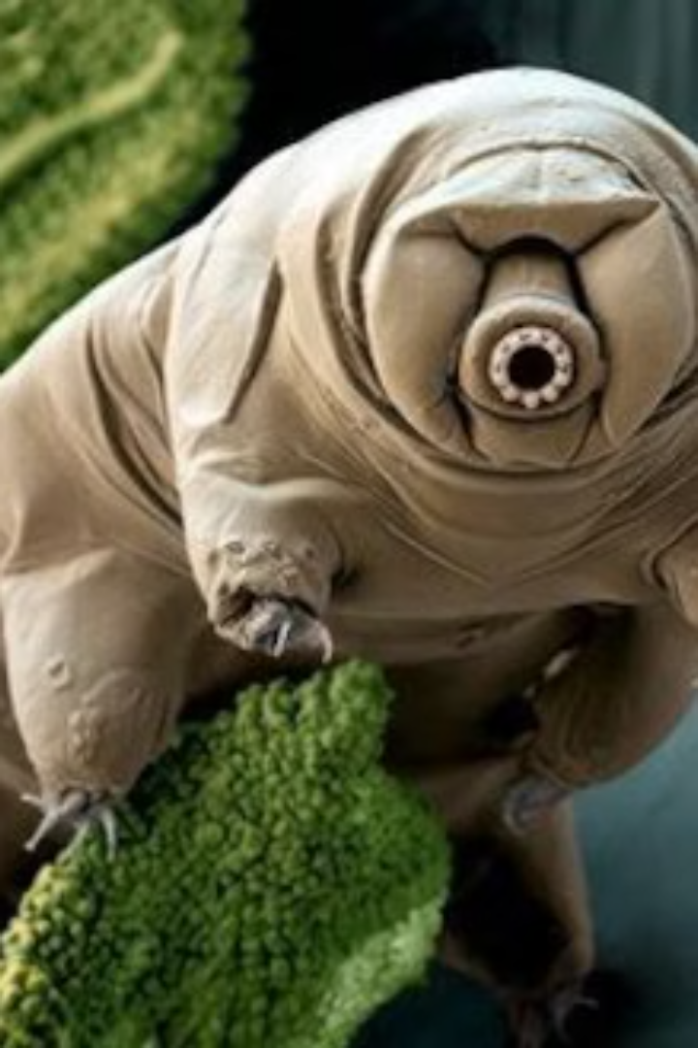
Survival of tardigrades in subzero temperatures
Welcome! Today we'll dive into my research on tardigrades, exploring a unique database and the exciting questions it raises.
by Anna Shilling Bakalinsky
Notes:
שלום

Slide 2
Scientific background: Tardigrades
Research Focus
Unknown Mechanisms
Survival Strategies
Research is focused on elucidating the mechanisms of tardigrade cold temperature survival.
Tardigrades exhibit remarkable survival abilities.
The underlying mechanisms of tardigrade cold temperature survival remain largely unknown, prompting further investigation.
They can withstand extreme desiccation.
This includes exploring freeze avoidance and tolerance strategies.
They likely employ diverse strategies for cold temperature survival.

Slide 3
Tardigrade Cryobiology: Experimental Validation and Database Creation
Directional Freezing Microscopy: Core methodology enabling the following:
Direct observation of tardigrades surviving internal fluid freezing.
1. Observations
2. Recovery
Subsequent full recovery of the tardigrades.
3. Validation
Validating their remarkable cryobiotic capabilities.

Slide 4

Quantifying Tardigrade Cryosurvival: A Need for Standardized Metrics
While visual evidence of tardigrade survival after freezing exists:
1
A lack of standardized quantitative metrics is a significant limitation.
2
Without standardized measures, replication and validation of these findings are challenging.
3
The scientific community requires robust, quantifiable data to support these claims.

Slide 5




Methods: Bridging the Gap Between Visual Evidence and Quantitative Measures
Video Segmentation:
Breaking down the video into individual frames at a specific rate, thus creating images.
Machine Learning Segmentation:
Using YOLO11 Instance Segmentation to identify tardigrades within each image.
Pixel Intensity Calculation:
Determining each tardigrade's average pixel value (brightness) in every frame using K-means.
Data Visualization:
Plotting the average pixel values over time axis to visualize changes in tardigrade brightness.

Slide 6
Conclusions: Shaping the Future
Key Findings
1
Providing standard quantitative metrics that allow alignment with other studies
in the field around the world.
Limitations
2
The main limitation is the inaccuracy of detecting the Tardigrades. Over time, the more exposure the model has to these microscope images, the more accurate it will become.
Future Directions & Impact:
By expanding the method's capabilities to identify and track various objects based on color changes and developing a user-friendly application, we aim to create a versatile tool for quantitative analysis of biological processes, enhancing our understanding of tardigrade cryobiology and beyond.
3

Slide 7
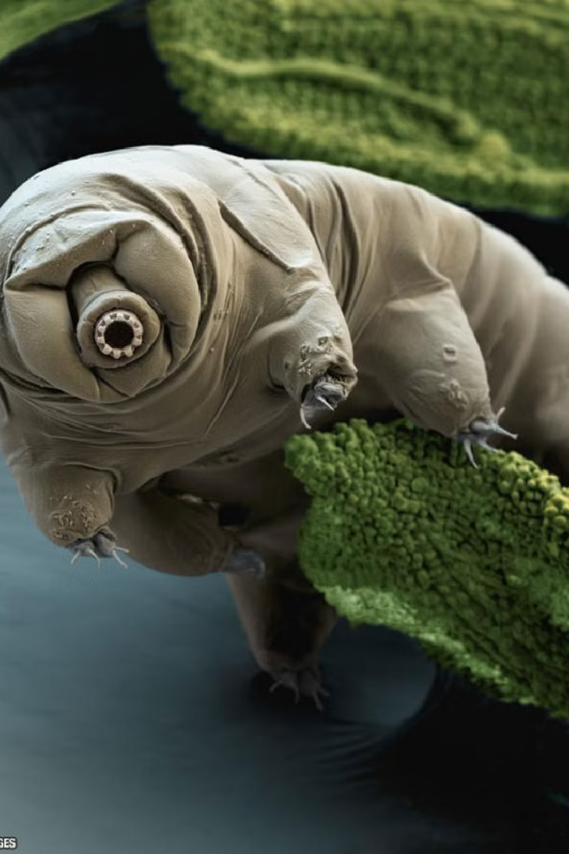
Moving Forward: The Next Steps
1
Developing an application in Streamlit
To allow users all over the world to use the method efficiently and conveniently
2
Expand the method's capabilities:
To identify Tradegrades and other objects and continue processing based on color changes.

